Slide 1

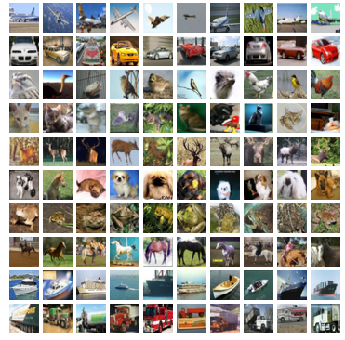
Cifar10 Image Classification based on CNN
Group 7
Jay Choksi
Ruta Lad
Mohan Liu
Anqi Ren

Slide 2
Objective
Build a Convolutional Neural Network for recognizing images Using Keras
Train the model with different combination of parameters
Optimize the model to high accuracy

Slide 3
Dataset
Overview
Totally 60,000 32x32 colour images
10 classes (6000 image per class)
Training Set: 50,000 images
Test Set: 10,000 images
Divided into 6 batchs:
5 Training batch & 1 Test Batch
Each batch has 10,000 images

Slide 4
Dataset
Preprocessing
Import the data using keras.datasets, and split between train and test sets
Use One-hot coding, convert class vectors to binary class matrices.
The value range of pixel points is normalized from [0, 255] to
[0, 1]

Slide 5
Convolutional Neural Network
Convolutional Neural Networks are a category of Neural networks that have proven very effective in areas such as image recognition and classification
There are four main operations in the CNN
Convolution
Non Linearity (ReLU)
Pooling or Sub Sampling
Classification (Fully Connected Layer)

Slide 6
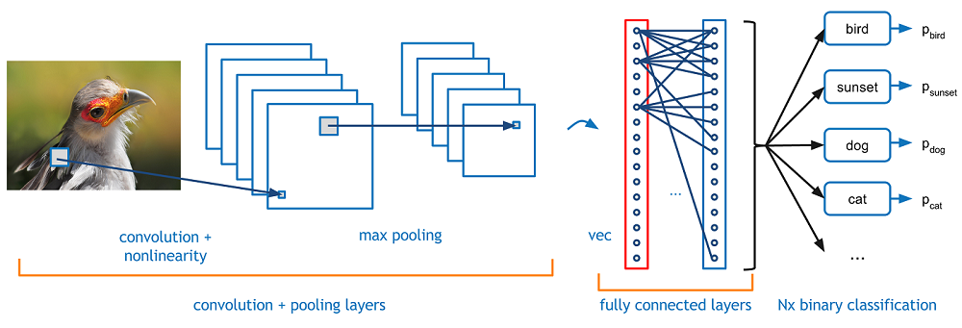
Convolutional Neural Network

Slide 7
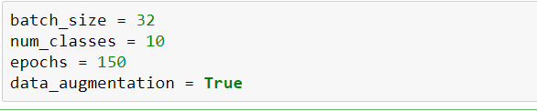
IMPLEMENTATION
Batch_size: Batch size defines number of samples that going to be propagated through the network. Here we have defined batch_size as 32
Num_classes: Number of categories of objects to be detected in the dataset
Epochs: Epoch means one pass of the full training set. Usually it may contain a few iterations.
Data_augmentation: Data augmentation artificially creates training images through different ways of processing or combination of multiple processing, such as random rotation, shifts, shear and flips, etc.

Slide 8
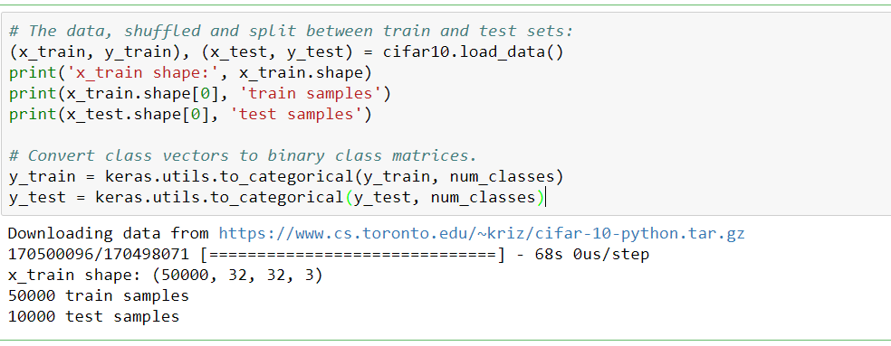
Here we are downloading the data and splitting it into train and test data
Code:

Slide 9
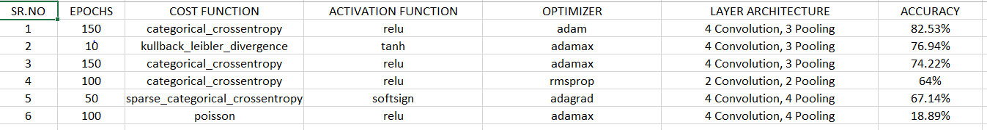
Other Different Combinations

Slide 10
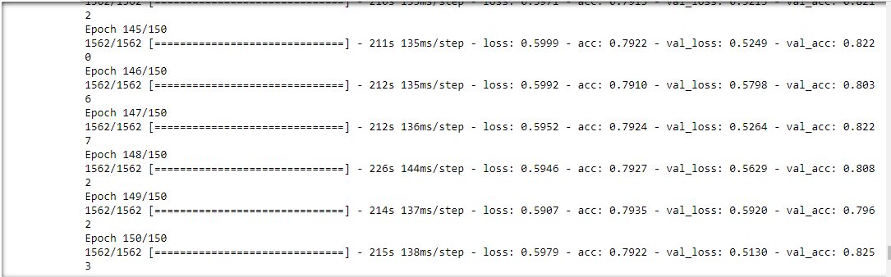
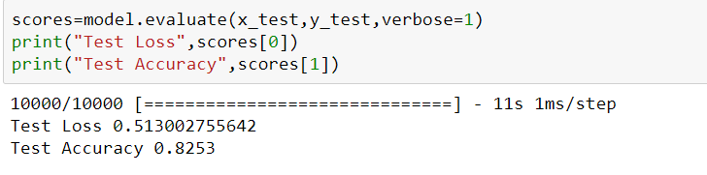
Results

Slide 11
Conclusions:
After trying different combinations, the best accuracy what we receive was 82.53% on test data set.

